Slide 1
Asymptotic Notations
Md. Muktar Hossain
Lecturer
Dept. of CSE
Varendra university

Slide 2
Introduction
Asymptotic Notations are mathematical tools used to analyze the performance of algorithms by understanding how their efficiency changes as the input size grows.
There are mainly three asymptotic notations:
Big-O Notation (O-notation) ---- Worst Case
Omega Notation (Ω-notation) ---- Best Case
Theta Notation (Θ-notation) ---- Average Case

Slide 3
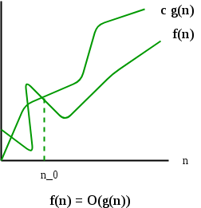
Big-O Notation (O-notation)
The upper bound of the running time of an algorithm. Therefore, it gives the worst-case complexity of an algorithm.
O(g(n)) = { f(n): there exist positive constants c and n0 such that 0 ≤ f(n) ≤ cg(n) for all n ≥ n0 }
Example: Let us consider a given function, f(n)=4n³+10n²+5n+1
Considering g(n)=n³,
f(n)⩽20g(n), for all the values of n>0
Hence, the complexity of f(n) can be represented as O(g(n)), i.e. O(n³)

Slide 4
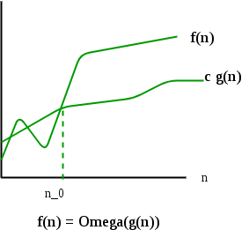
Omega Notation (Ω-Notation)
The lower bound of the running time of an algorithm. Thus, it provides the best case complexity of an algorithm.
Ω(g(n)) = { f(n): there exist positive constants c and n0 such that 0 ≤ cg(n) ≤ f(n) for all n ≥ n0 }
Example: Let us consider a given function, f(n)=4n³+10n²+5n+1
Considering g(n)=n³
f(n)⩾4g(n), for all the values of n>0
Hence, the complexity of f(n) can be represented as Ω(g(n)), i.e. Ω(n³)

Slide 5
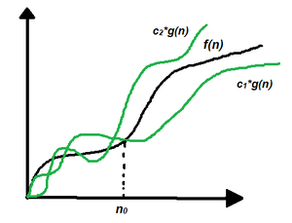
Theta Notation (Θ-Notation)
The upper and the lower bound of the running time of an algorithm, it is used for analyzing the average-case complexity of an algorithm.
Θ (g(n)) = {f(n): there exist positive constants c1, c2 and n0 such that 0 ≤ c1 * g(n) ≤ f(n) ≤ c2 * g(n) for all n ≥ n0}
Example: Let us consider a given function, f(n)=4n³+10n²+5n+1
Considering g(n)=n³
4.g(n)⩽f(n)⩽20.g(n), for all the large values of n.
Hence, the complexity of f(n) can be represented as θ(g(n)), i.e. θ(n³)

Slide 6
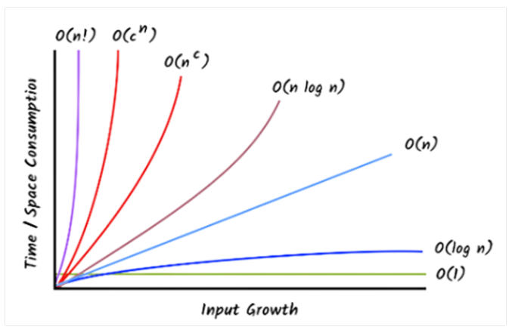
Common Asymptotic Notations
Name | Notation
Constant | O(1)
Logarithmic | O(log n)
Linear | O(n)
Linearithmic, Log-linear | O(n log n)
Quadratic | O(n²)
Polynomial | O(n^{c})
Exponential | O(c^{n}); where c>1
Factorial | O(n!)

Slide 7
Problems for Practice

Slide 8
1. Consider the following functions representing the runtime of different algorithms:
f(n)=8n²+3n+10; g(n)=5n+100; h(n)= 2n³+7
i. Determine the asymptotic complexity (Big-O) of each function. ii. Rank them in terms of efficiency for large n, explaining your reasoning.
2. Consider the following functions representing the runtime of different algorithms:
f(n)=6n³+2n²+15; g(n)=4n+log n; h(n)= 3n²+100
i. Determine the asymptotic lower bound (Big-Ω) of each function. ii. Rank the functions based on their minimum growth rate and explain.
3. Consider the following functions representing the runtime of different algorithms:
f(n)=2n²+50n+20; g(n)=7n+5; h(n)= 10n³+n²+2
i. Prove that each function belongs to a specific asymptotic class using Big-Θ notation. ii. Rank them by asymptotic growth rate with explanation.

Slide 9
Complexity Analysis of Recurrence Relation

Slide 10
Definition
A recurrence relation is a mathematical expression that defines a sequence in terms of its previous terms.
General form of a Recurrence Relation:
$a_{n}=f(a_{n−1}$, $a_{n−2}$, ... $a_{n−k})$
Example:
Fibonacci Sequence | F(n) = F(n-1) + F(n-2)
Factorial of a number n | F(n) = n * F(n-1)
Merge Sort | T(n) = 2*T(n/2) + O(n)
Binary Search | T(n) = T(n/2) + 1

Slide 11
Solving Technique
Solving recurrences plays a crucial role in the analysis, design, and optimization of algorithms.
There are mainly three ways of solving recurrences:
Substitution Method
Recurrence Tree Method (Study yourself)
Master Method

Slide 12
Substitution Method
It uses following steps to find Time Complexity using recurrences:
Take the main recurrence and try to write recurrences of previous terms
Take just previous recurrence and substitute into main recurrence
Again take one more previous recurrence and substitute into main recurrence
Do this process until you reach to the initial condition
After this substitute the the value from initial condition and get the solution

Slide 13
Substitution Method Cont’d
Recurrence Relation: $T\left(n\right)= \left\{\begin{aligned}1 , if n=1 \\ T\left(\frac{n}{2}\right)+C, if n>1\end{aligned}\right\}$
Solution:
$$T\left(n\right)=T\left(\frac{n}{2}\right)+C………………\left(1\right)$$
$$T\left(\frac{n}{2}\right)=T\left(\frac{n}{4}\right)+C………………\left(2\right)$$
$$T\left(\frac{n}{4}\right)=T\left(\frac{n}{8}\right)+C………………\left(3\right)$$
After substituting (2) into (1), we get,
$$T\left(n\right)=T\left(\frac{n}{4}\right)+2C$$
$$=T\left(\frac{n}{4}\right)+2C=T\left(\frac{n}{2^{2}}\right)+2C$$
$$=T\left(\frac{n}{8}\right)+3C$$
$$=T\left(\frac{n}{2^{3}}\right)+3C$$
………………
$$=T\left(\frac{n}{2^{k}}\right)+kC$$
$$=T\left(1\right)+kC ,[\text{Assume}\text{, }\frac{n}{2^{k}}=1 or n= 2^{k}]$$
$$=1+kC$$
Here, $n= 2^{k}$.
So, $k=\log{n}$
Hence, $T\left(n\right)=O(\log{n)}$

Slide 14
Substitution Method Cont’d
Calculate the Big-O notation of the following recurrences using Substitution method:
$T\left(n\right)= \left\{\begin{aligned} 1 , if n=1 \\ 2T\left(\frac{n}{2}\right)+n, if n>1\end{aligned}\right\}$
$T\left(n\right)= \left\{\begin{aligned} 1 , if n=1 \\ n∗T\left(n−1\right), if n>1\end{aligned}\right\}$

Slide 15
Master Method (Theorem)
Usually used for divide and conquer algorithm.
Required Form:
$T\left(n\right)=aT\left(\frac{n}{b}\right)+f\left(n\right) or T\left(n\right)=aT\left(\frac{n}{b}\right)+θ\left(n^{k}\log^{p}n\right) , where a≥1, b>1, k≥0$
Solution:
Condition |  | T(n)
$${a>b}^{k}$$ |  | $${θ(n}^{\log_{b}{a}})$$
$${a=b}^{k}$$ | $$p>−1$$ | $${θ(n}^{\log_{b}{a}}\log^{p+1}n)$$
 | $$p=−1$$ | $${θ(n}^{\log_{b}{a}}log log n)$$
 | $$p<−1$$ | $${θ(n}^{\log_{b}{a}})$$
$${a<b}^{k}$$ | $$p≥0$$ | $$θ\left(n^{k}\log^{p}n\right)$$
 | $$p<0$$ | $$θ\left(n^{k}\right)$$
Here, n = size of the problem a = number of sub-problems and a >= 1 n/b = size of each sub-problem b > 1, k >= 0 and p is a real number.

Slide 16
Master Method Cont’d
Recurrence Relation: $T\left(n\right)= \left\{\begin{aligned}1 , if n=1 \\ T\left(\frac{n}{2}\right)+C, if n>1\end{aligned}\right\}$
Solution:
Here, a = 1, b = 2, k = 0, p = 0.
a = 1 = 2⁰ = b^{k} and p > -1.
So,
$${\text{T}\text{(}\text{n}\text{) =} θ(n}^{\log_{2}{1}}\log^{0+1}n)$$
$${\text{=} θ(n}^{0}\log{n})$$
$$\text{=} θ (log{n})$$
Recurrence Relation: $T\left(n\right)= \left\{\begin{aligned} 1 , if n=1 \\ 3T\left(\frac{n}{2}\right)+\log^{2}n, if n>1\end{aligned}\right\}$
Solution:
Here, a = 3, b = 2, k = 0, p = 2.
a > 1 = 2⁰ = b^{k}
So,
$${\text{T}\text{(}\text{n}\text{) =} θ(n}^{\log_{2}{3}})$$

Slide 17
Master Method Cont’d
Calculate the Big-O notation of the following recurrences using Master method:
$T\left(n\right)= \left\{\begin{aligned} 1 , if n=1 \\ 2T\left(\frac{n}{2}\right)+n, if n>1\end{aligned}\right\}$
$T\left(n\right)= \left\{\begin{aligned} 1 , if n=1 \\ 8T\left(\frac{n}{2}\right)+n^{2}, if n>1\end{aligned}\right\}$
$T\left(n\right)= \left\{\begin{aligned} 1 , if n=1 \\ 3T\left(\frac{n}{2}\right)+n^{2}, if n>1\end{aligned}\right\}$

Slide 18
Homework
1. Determine when it is suitable to apply Substitution Method and when it is not.
2. Determine when it is suitable to apply Master Method and when it is not.

